Slide 1

About Herody:
Herody started with the vision of providing a gig work platform to brands & gig workers. We are a brand’s as well as gig worker’s best friends.We break down the complex business requirements in form of tasks and take ownership of end–to–end execution.
Currently, the product is present in form of a mobile application and website.

Slide 2
Key Metrics
01
100k+ User Base on product collectively.
02
20k+ Gigjobs Generated
03
Worked with 200+ brands
04
Robust Tech Platform where relevant pairing of Gigworkers and companies are done
05
Total 500k+ Gigs Completed
06
Revenue of INR 2.5 Cr+ in total

Slide 3

Important features in our application:
Gigs
Gigs are short-term tasks that can be completed on the go and can help you earn easily. Users/Gigworkers can complete these from the comfort of their homes.
01
Internships
02
Complete Internships with big brands such as Amazon, Flipkart, Times Internet, etc. for a certain period of time and also get a stipend of up to Rs. 15,000 and a Certificate of Internship as well.
Projects
03
Complete short-term and long-term projects with major brands across India and earn Rs.15,000-Rs.20,000 from the comfort of your home.
04
Build Resume
Build your Resume with the latest data-driven technology and make a solid resume that will speak about you in front of the employers.
05
Referral
Earn 5% of your friend's lifetime earnings by referring them to Herody. You can redeem all your earnings directly in your Paytm Wallet/Amazon Pay.

Slide 4
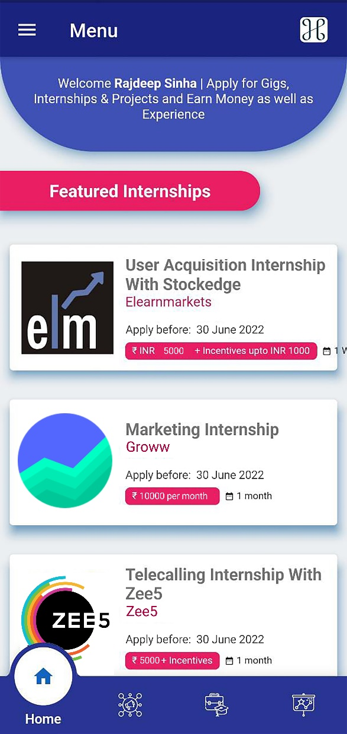
Home Page
The Home Page shows the featured Gigs, projects & internships for the Gigworkers.
We also list the offers on our Home Page.

Slide 5

Gigs - User Interface & Details
Short Term Tasks can be completed on the go by Gigworkers primarily students.
Once the task is completed they can submit the proofs via our tech stack itself.
They can apply for it by going on our app( Screenshots below)
The companies which post these gigs are provided with an employer console where they can check the status of the completed & non completed gigs.
Once, the gig is successfully completed the user will get the amount in their wallet which can be transferred to Paytm/Bank.

Slide 6
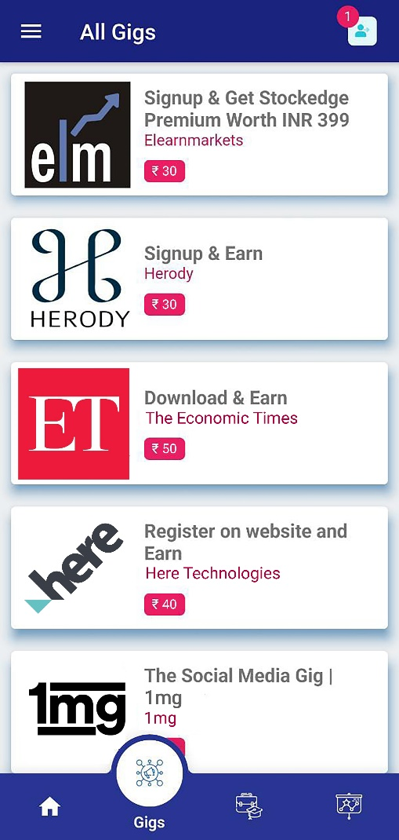
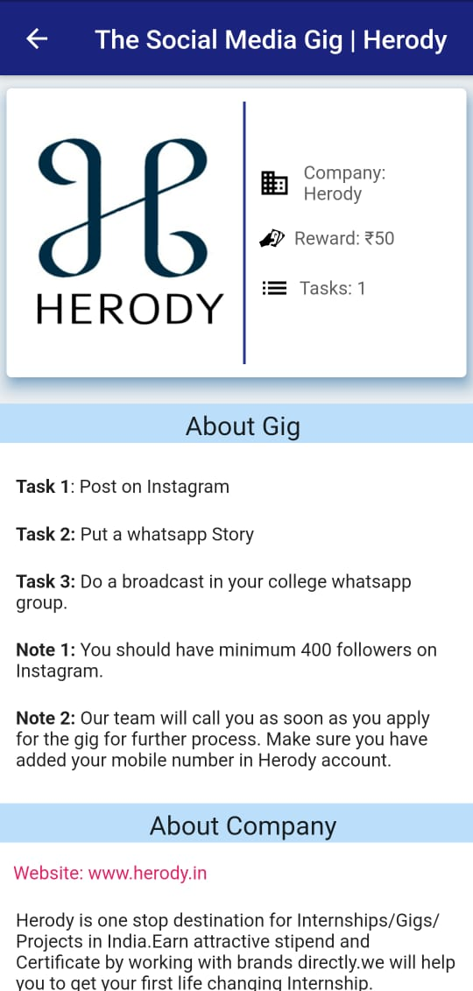

Gigs listing page
Apply page for gigs
Proof submission page

Slide 7
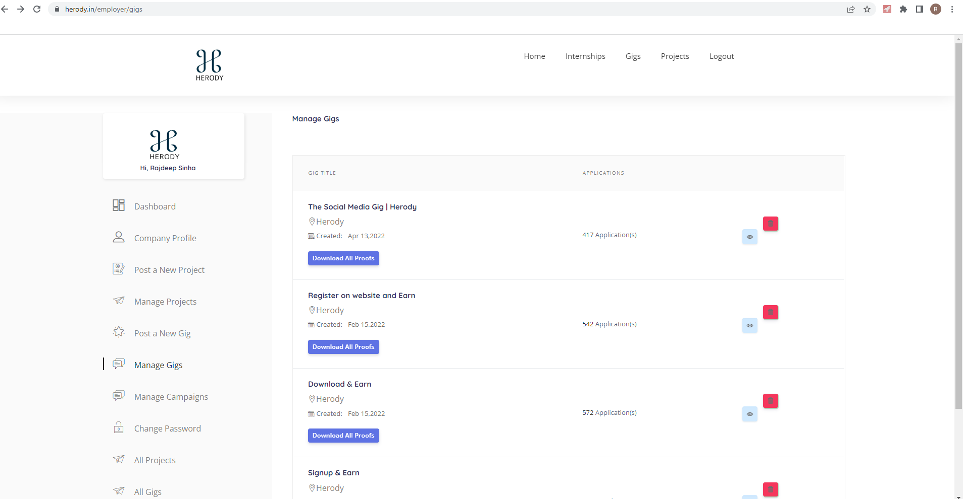
Admin Console for Companies to evaluate the Gigs

Slide 8
Internship - User Interface & Details
The whole process can be completed via our application.
Internships can be in Marketing, Tech, Content & Data Operations, Sales, Telecalling etc.
Companies outsource their tasks to us and we get it done via distributed college workforce by making it virtual Internships.
The whole journey can be completed on our app itself and post successful completion the users will be paid accordingly.
Once, the gig is successfully completed the user will get the amount in their wallet which can be transferred to Paytm/Bank.
Once the internship is done the proofs can be submitted via the application itself.

Slide 9
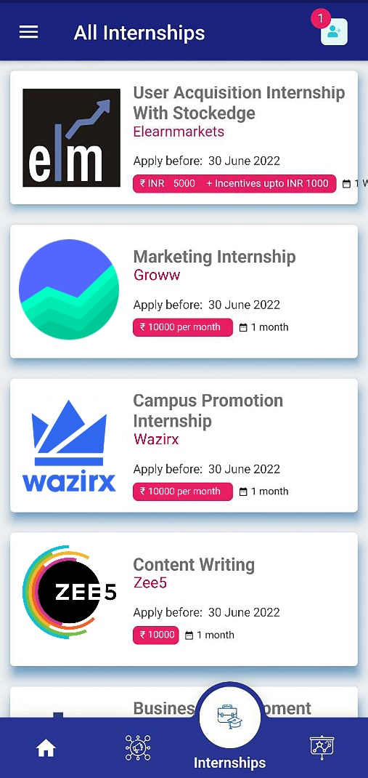
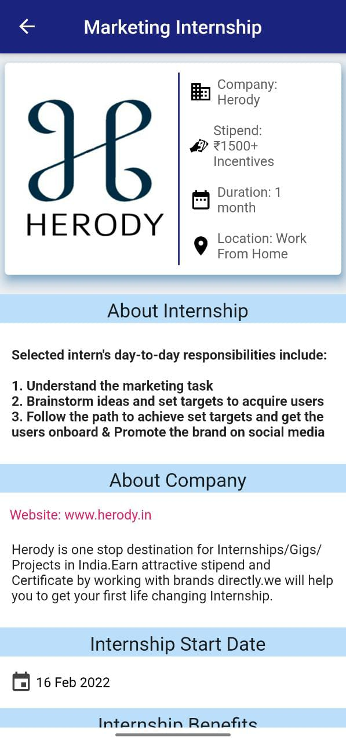
Internship listing page
Internship listing details

Slide 10
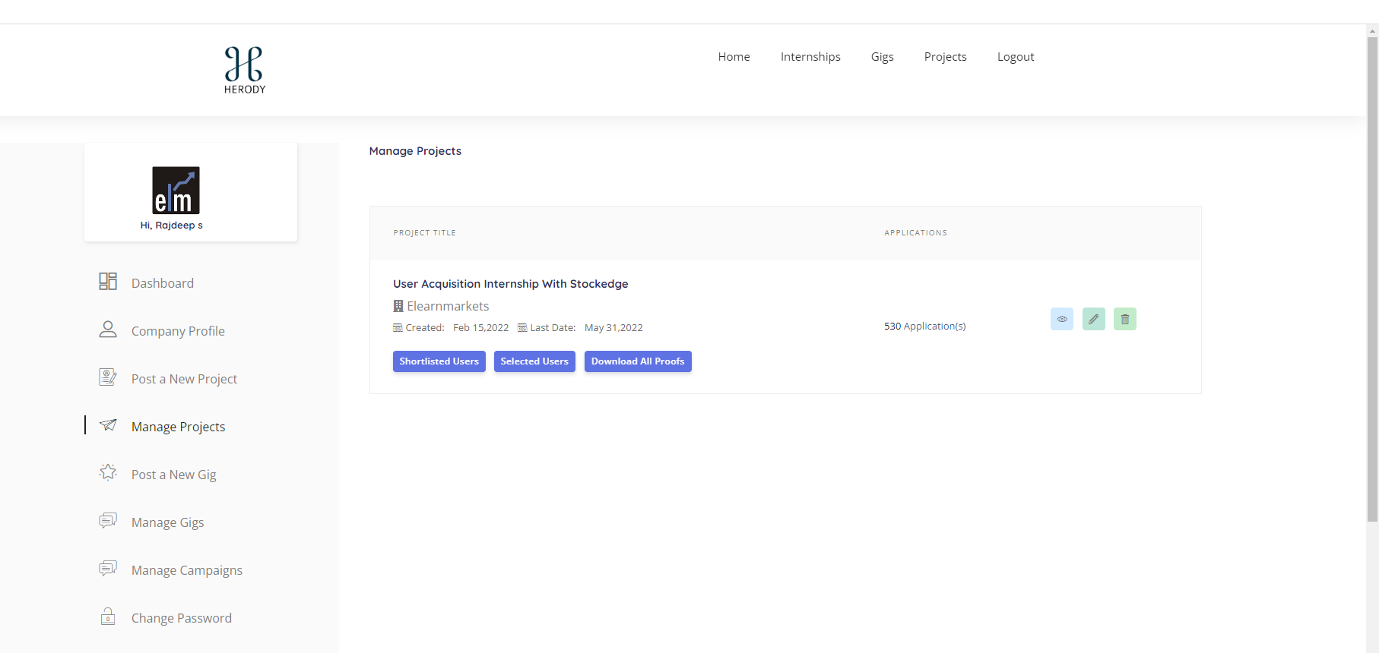
Internship Admin Console - for companies

Slide 11
Projects - User Interface & Details
Long-term tasks from companies are categorized as projects which can be completed by the Gigworkers.
The whole process can be completed via our application.
Projects can be Field Verification Surveys, Sales and Marketing, Background Verification, Field Sales, etc.
Once the Gigworker completes the project they can submit their proofs inside the application which can be verified later at the backend.
The amount upon successful completion is added to their Herody wallet.

Slide 12
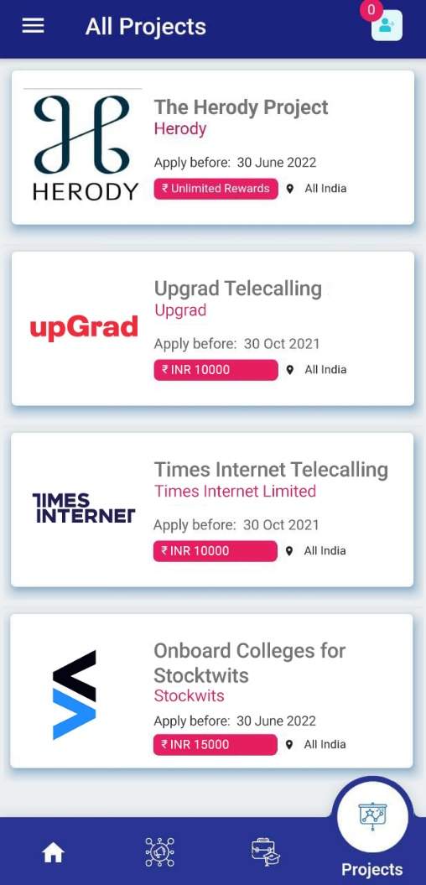
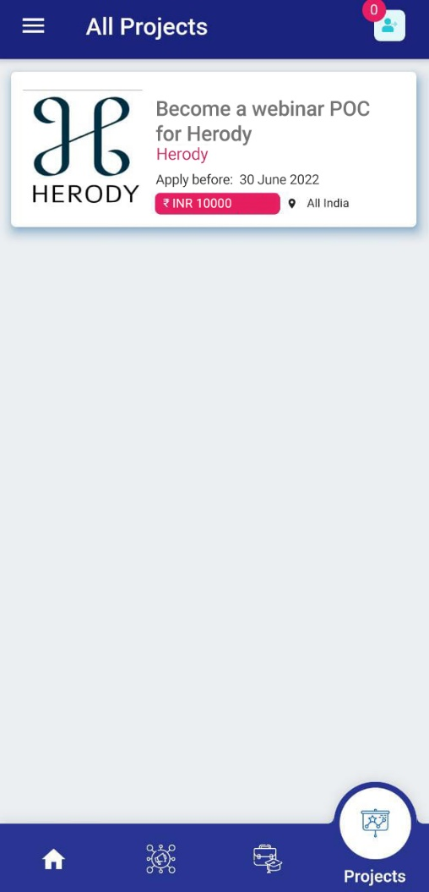
Project listing page

Slide 13
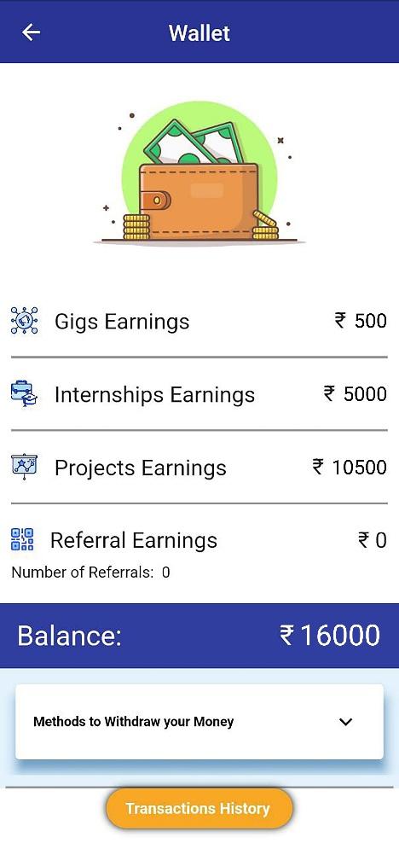
Wallet
 | Users receive their payments upon task completion in this wallet.
 | They can withdraw the amount via their Paytm Wallet or Bank Transfer.
01
02

Slide 14
Thank you

